Slide 1
EC LAB 1
Name : Snehal Keshav Nalawade
Roll No. : 202151160
Date : 24/01/2022

Slide 2
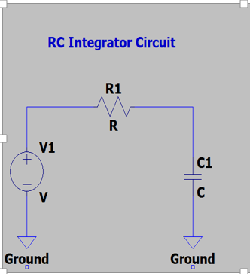
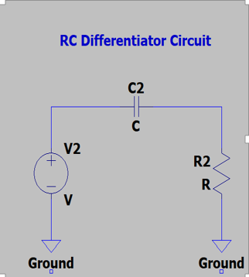
Objective : To Study the Time and Frequency response of RC circuits.
1) Circuit Diagrams :
a)
b)
2)
The value of R and C is varied in various cases of the experiment, so that different relations between time constant and time period(T) is achieved.
Time constant (tau) = RC
Transient response (time required by the capacitor to charge fully) = 5RC (approximately).

Slide 3
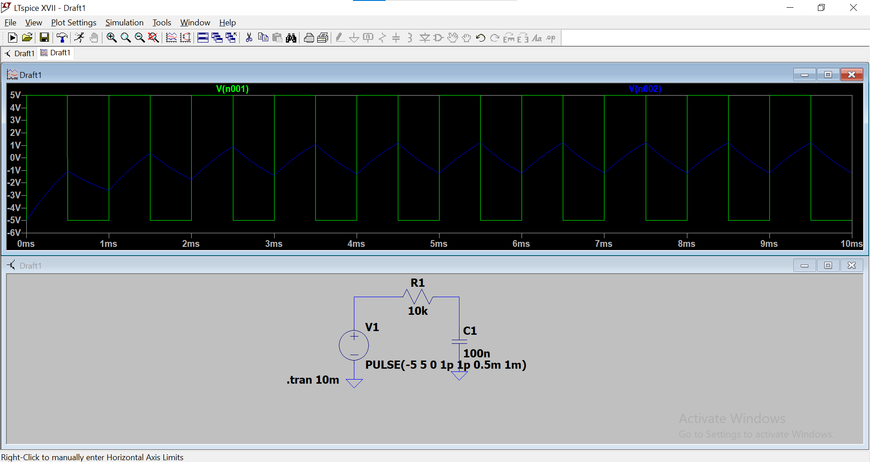
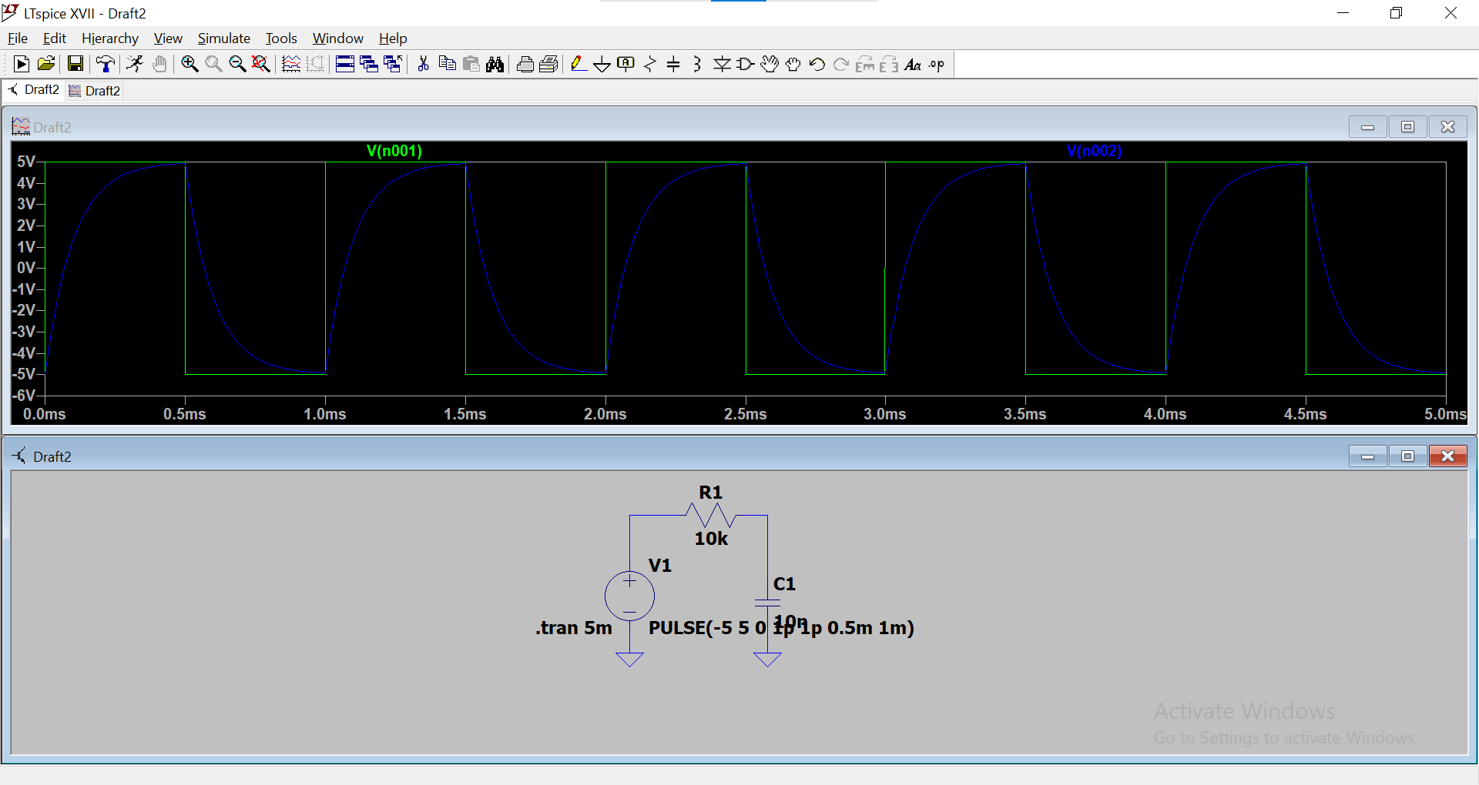
3) Time response :
RC Integrator Circuit :
1.) T << RC
2.) T = RC

Slide 4
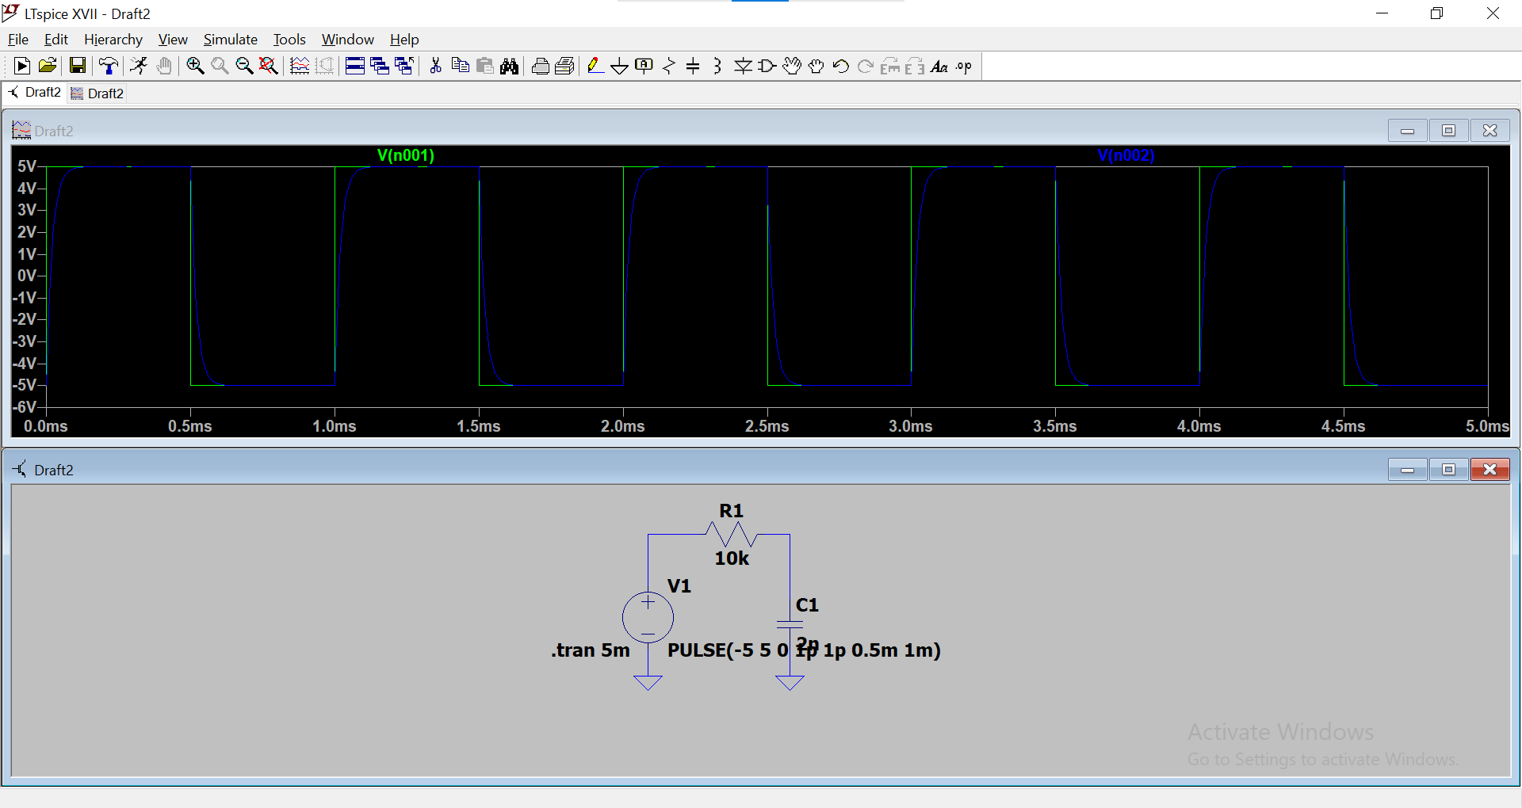
3.) T >> RC

Slide 5
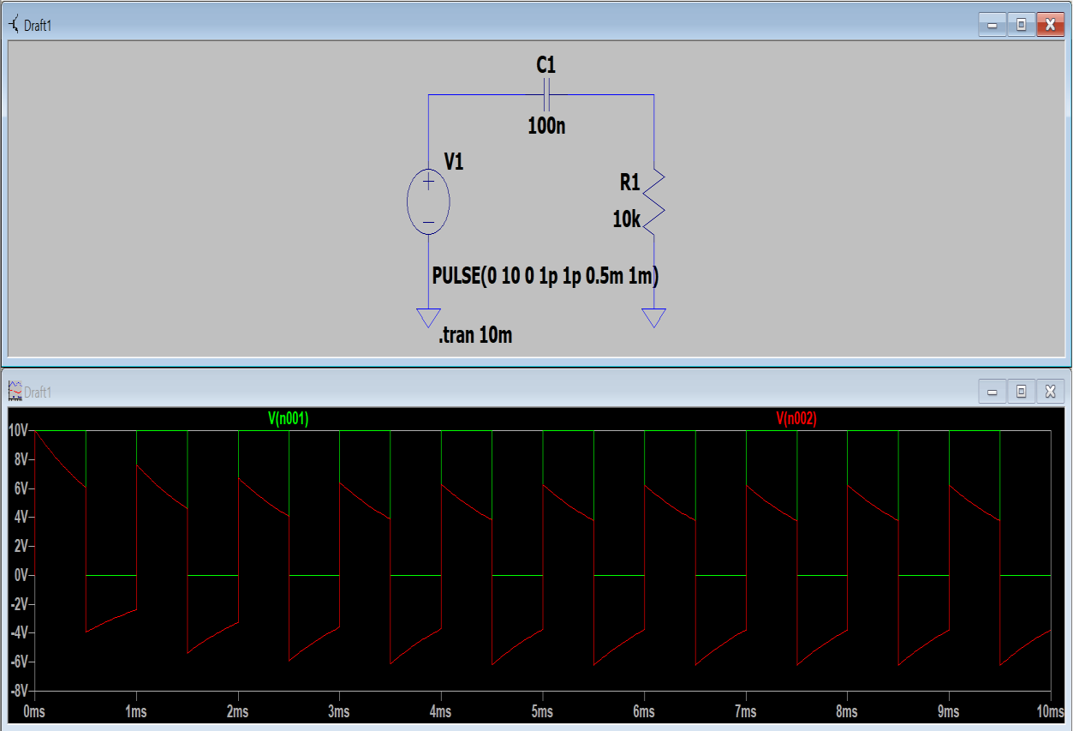
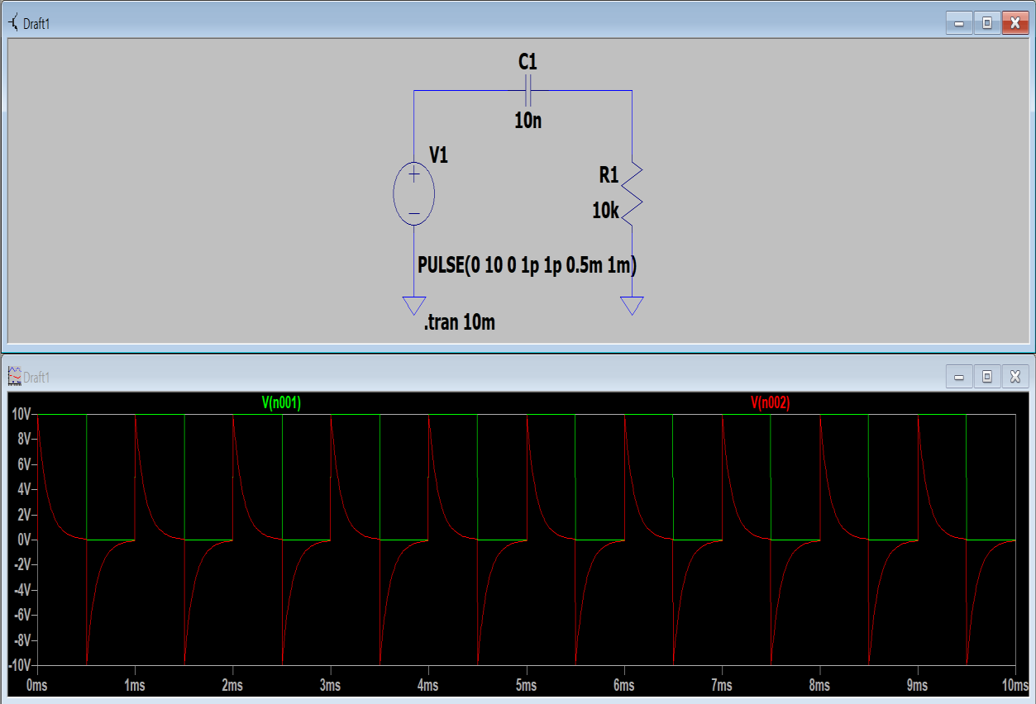
RC Differentiator Circuit :
1.) T << RC
2.) T = RC

Slide 6
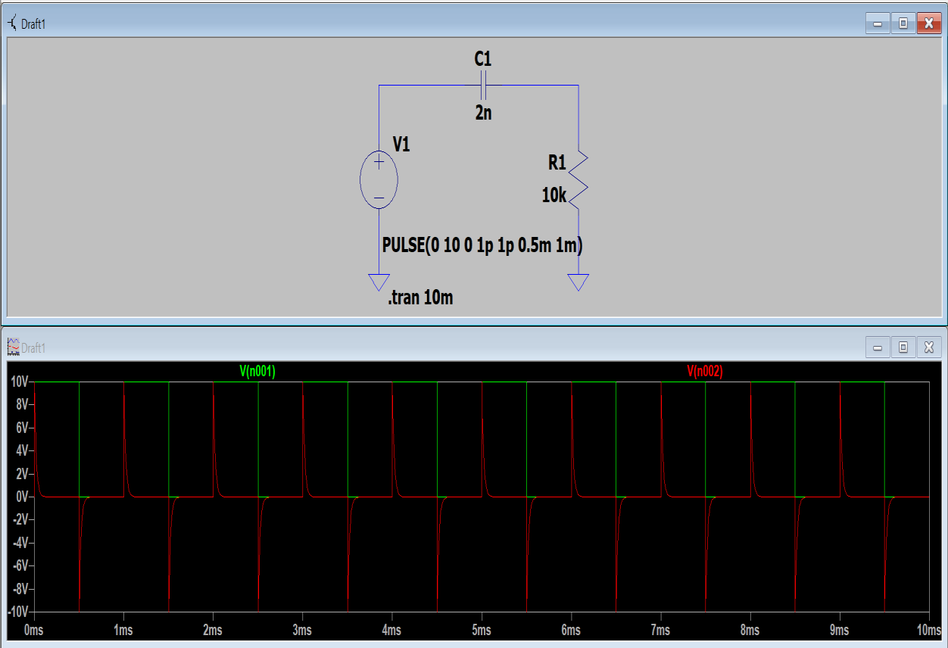
3.) T >> RC

Slide 7
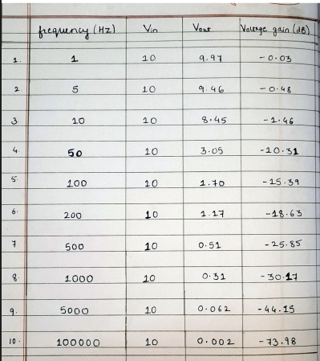
4) Frequency Response of Low Pass filter :

Slide 8
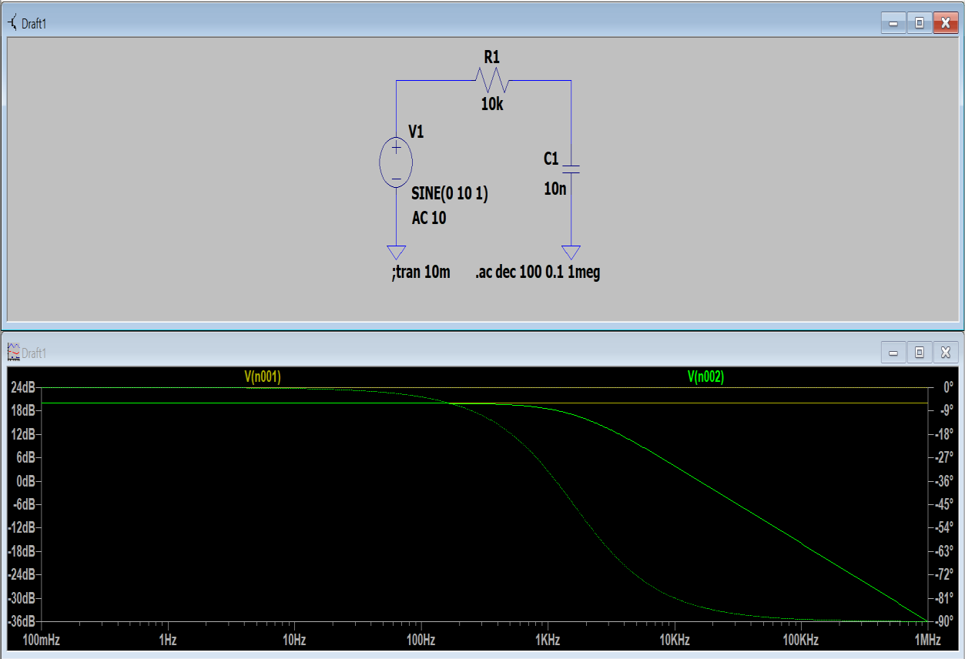
5) Voltage gain(in dB) vs Frequency graph :
6) Results : The experiment demonstrates how the relation between T and RC affects both, the Integrator as well as the differentiator circuit.
This Experiment also shows that an RC Integrator circuit acts as a Low pass filter.
Thank you

